Slide 1
Multiple Linear Regression

Slide 2
TYPES OF VARIABLE
Dependent Variables and Independent Variables
An independent variable, sometimes called an experimental or predictor variable, is a variable that is being manipulated in an experiment in order to observe the effect on a dependent variable, sometimes called an outcome variable

Slide 3
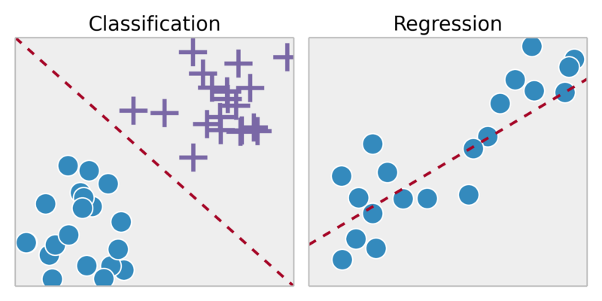
REGRESSION

Slide 4
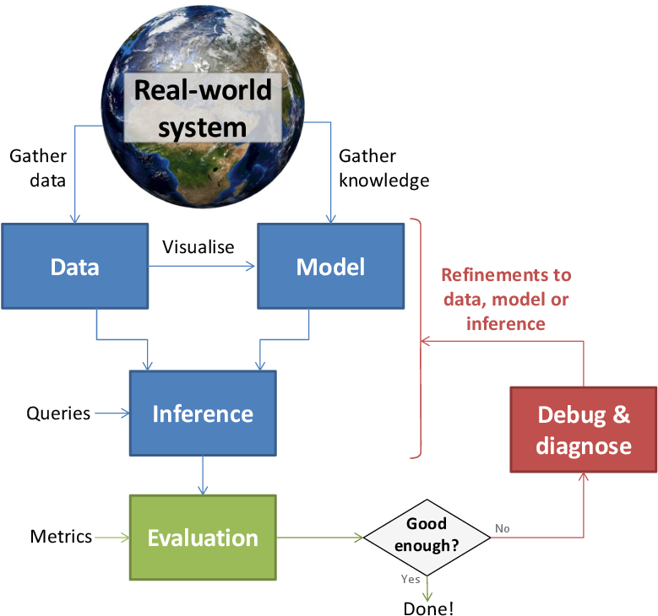
MACHINE LEARNING CYCLE
Training
Testing
Validation

Slide 5
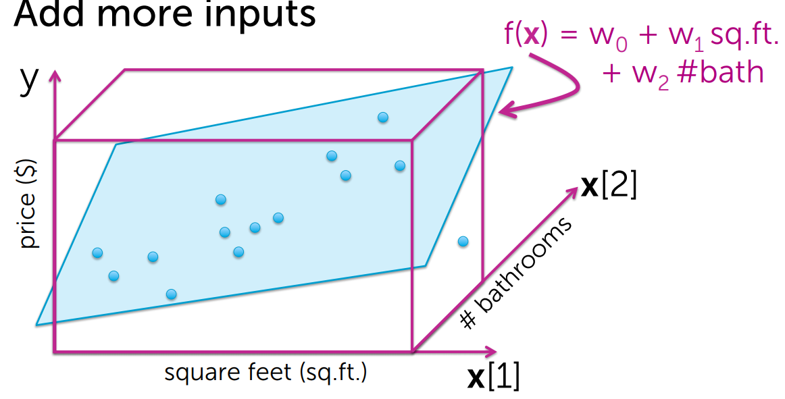
MULTIPLE LINEAR REGRESSION
Dimensionality changes addition of Features..

Slide 6
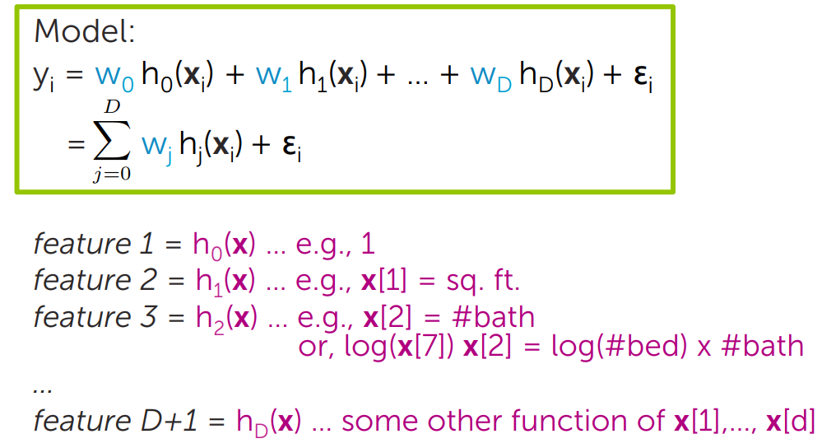
MORE GENERICALLY… D-DIMENSIONAL CURVE

Slide 7
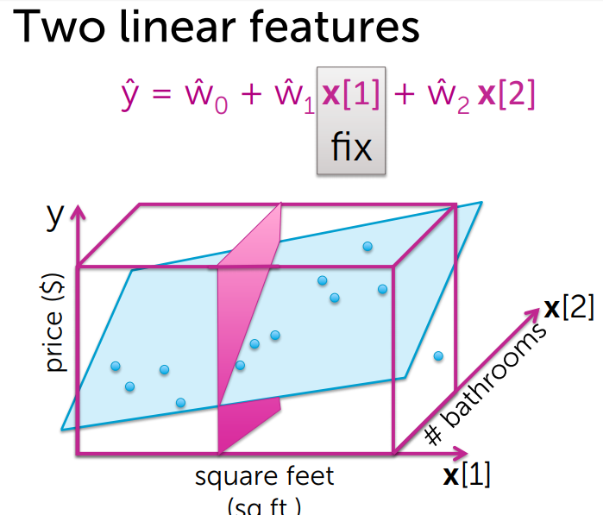
INTERPRETING THE FITTED FUNCTION
When we fix one feature and rest one unit increase what will be the changes in Y

Slide 8
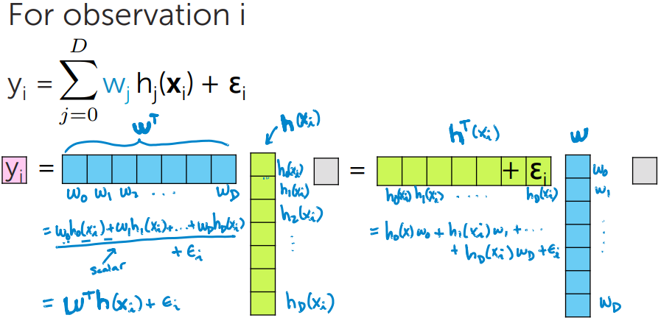
FITTING D-DIMENSIONAL CURVES
Step 1: Rewrite the regression model

Slide 9
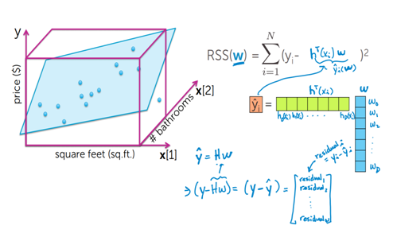
STEP 2: COMPUTE THE COST
RSS for multiple regression.

Slide 10
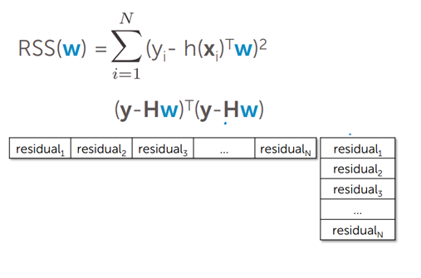
RSS IN MATRIX NOTATIONS

Slide 11
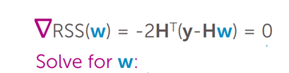
FINAL CALCULATION
Set the gradient = 0

Slide 12
APPROACH 2: GRADIENT DESCENT
Gradient descent is most powerful because earlier methods are highly computational intensive.

Slide 13
Thank You

